Slide 1
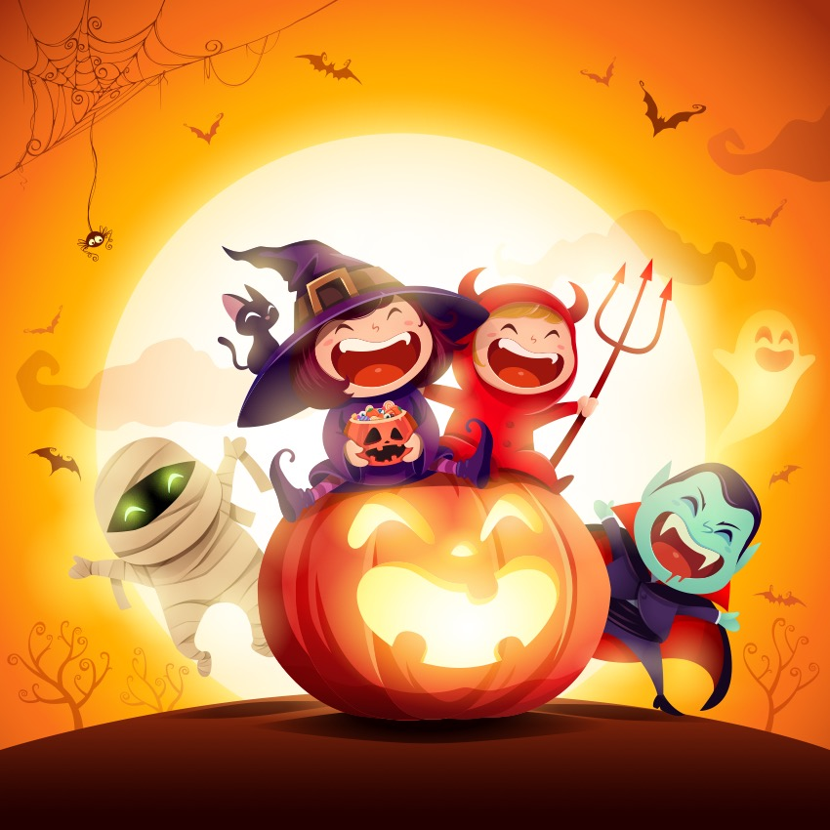

’S e Oidhche Shamhna a th’ ann!
Notes:
It’s Hallowe’en!

Slide 2
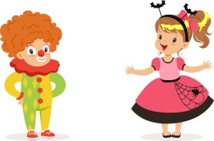
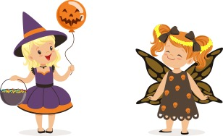
Tha sinn uile air bhioran.
Notes:
We are all excited.

Slide 3
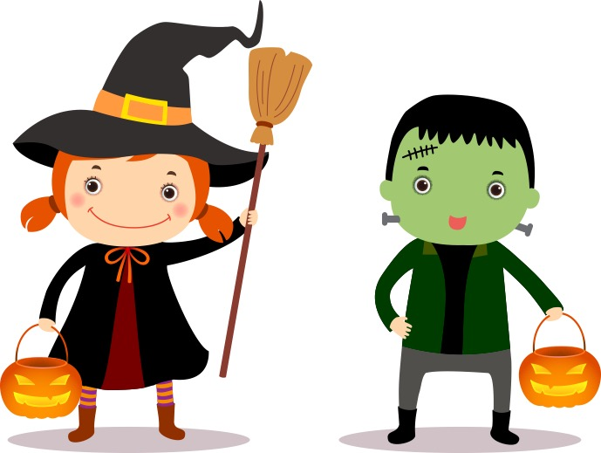
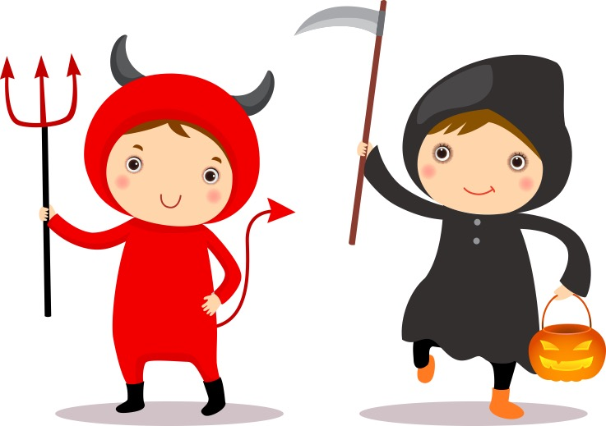
Bidh sinn a’ dol a-mach a-nochd agus bidh èididhean oirnn.
Notes:
We will be going out tonight and we’ll be wearing costumes.

Slide 4
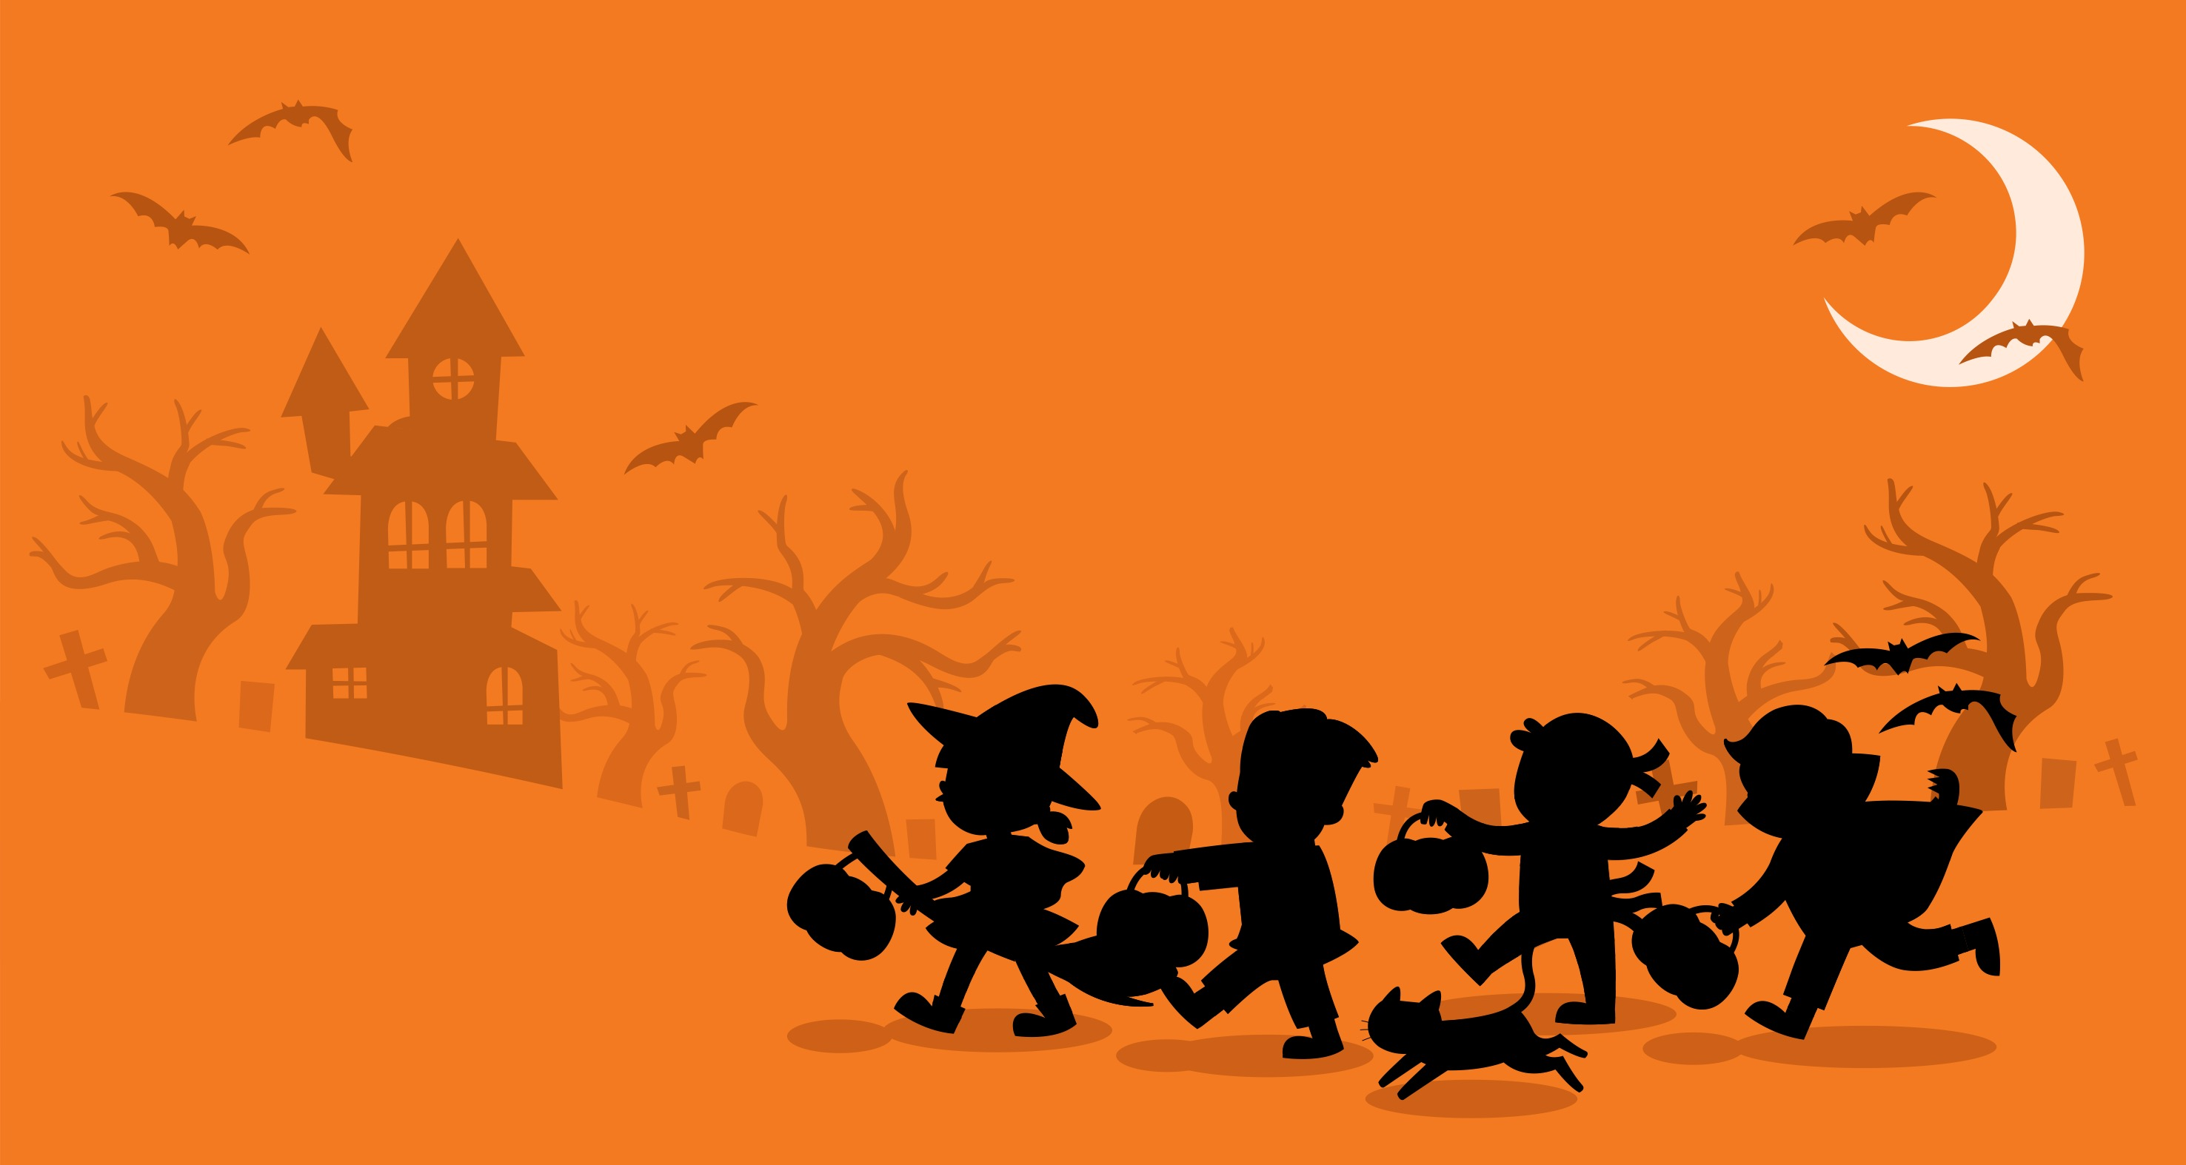
Bidh e dorcha ach cha bhi eagal oirnn air sgàth ’s gum bi inbheach còmhla rinn.
Notes:
It will be dark but we won’t be scared because an adult will be with us.

Slide 5
Bidh sinn a’ seinn agus a’ dannsa.
Notes:
We’ll be singing and dancing.

Slide 6
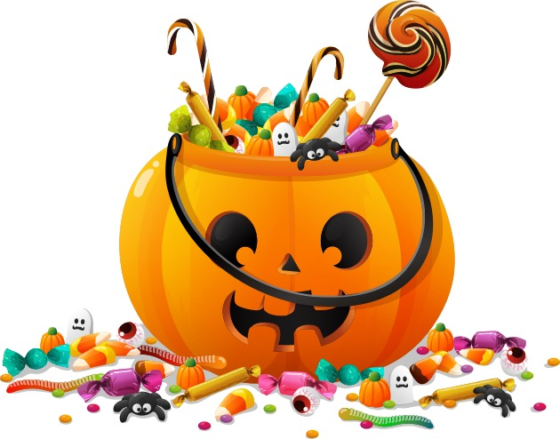
’S dòcha gum faigh sinn suiteis, seòclaid agus ùbhlan ma bhios sinn math air seinn agus dannsa.
Notes:
Perhaps we’ll get sweets, chocolate and apples if we’re good at singing and dancing.

Slide 7
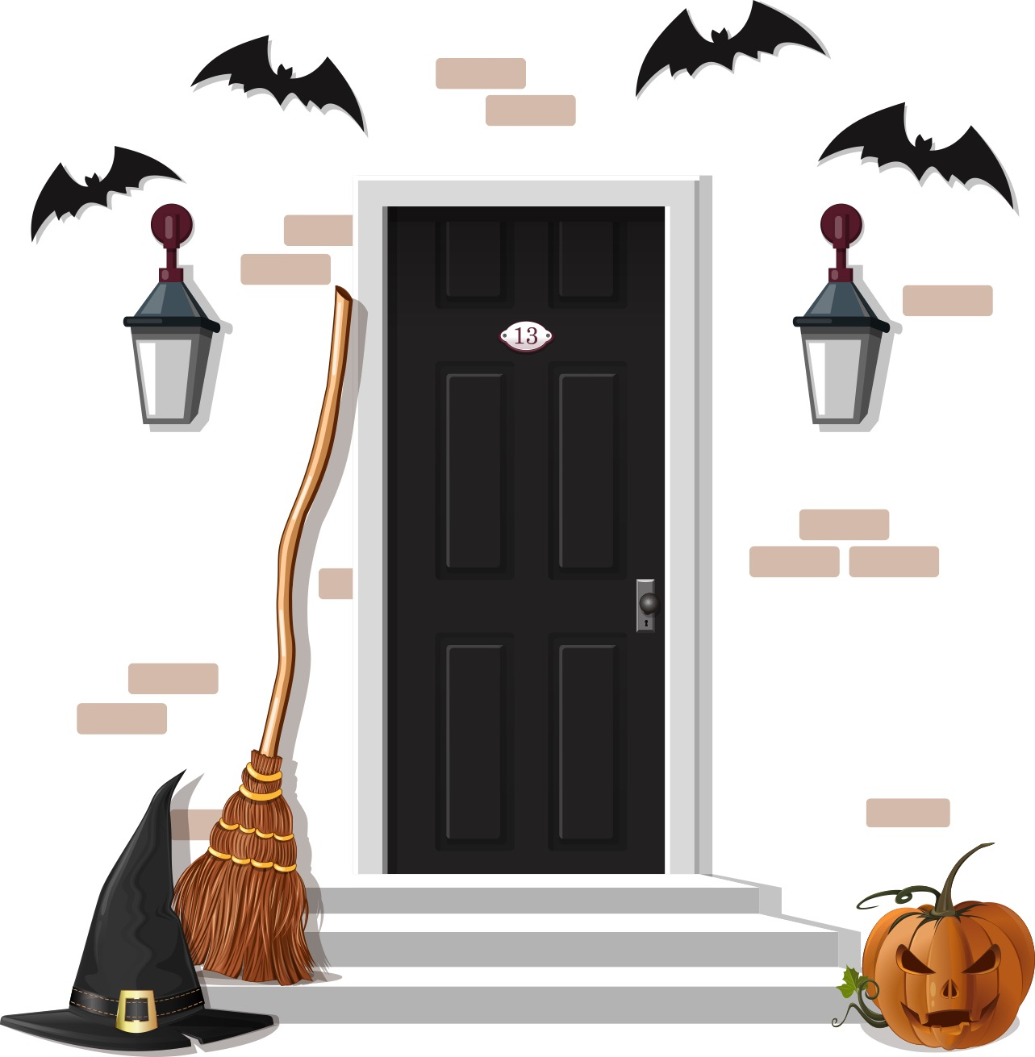
Cuiridh sinn peapag aig an doras agus tha sinn an dòchas gum bi clann eile a’ tighinn dhan taigh againne cuideachd.
Notes:
We’ll put a pumpkin at the door and we hope that other children will come to our house too.

Slide 8
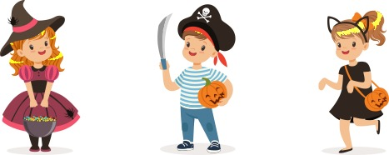
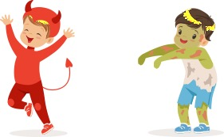
Bidh e math a h-uile duine fhaicinn leis na h-èididhean orra.
Notes:
It will be good to see everyone with their costumes on.

